Slide 1

B.M.S COLLEGE OF ENGINEERING
(Autonomous College Affiliated to Visvesvaraya Technological University, Belgaum)
Bull Temple Road, Basavanagudi , Bangalore-560019
MINI PROJECT II
Submitted by
Name USN
Niteeshkumar H V 1BM19EC098
Nitesh R 1BM19EC099
Padmaj U Naik 1BM19EC101
Pavan Kumar M 1BM19EC102

Slide 2
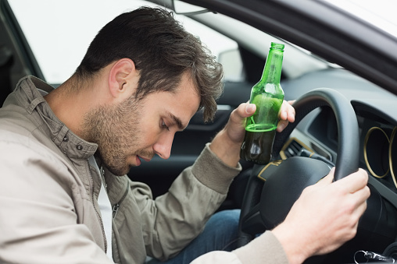
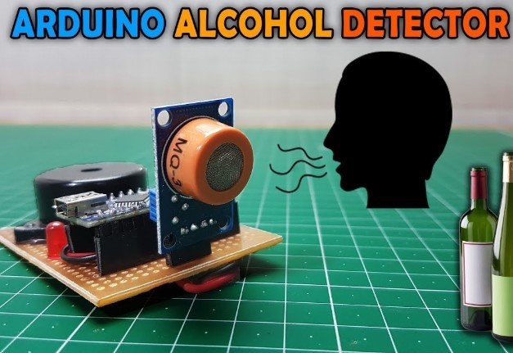
Alcohol sensing and automatic engine locking system and Location sharing

Slide 3
Abstract:
The main purpose behind this project is “DRUNK DRIVING DETECTION”.
Now a day’s many accidents happen because of the alcohol consumption of the person who is driving
the car.
The drunk driving is a major reason of accident . This project should be installed inside the vehicle.
In this project we have developed an automatic engine locking system using
Arduino UNO board - Microcontroller
MQ3 Sensor - Analog alcohol Sensor- Breath Analyzer.
DC Motor - Depicted as wheels of the car/vehicle
Buzzer/Alarm - To warn the driver
Relay - Connected to motors which is dependent on the values of MQ3 sensor.

Slide 4
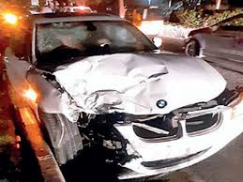
Brief facts
Approximately one-third of all traffic crash fatalities in the United States involve drunk drivers (with BACs of .08 g/dL or higher). In 2019, there were 10,142 people killed in these preventable crashes. In fact, on average over the 10-year period from 2010-2019, more than 10,000 people died every year in drunk-driving crashes
Indian roads continue to be one of the deadliest in the world. Of the 1.46 lakh people who lost their lives in road accident in 2015, 4.6% (6755) was caused by drunk drivers..
South Africa has the highest rate of drunk driving fatalities globally, with 25.1 deaths per 100,000 total population
As per the National statistics, an average of nearly 12,000 people die every year and an average of nine lakh people get arrested in DWI incidents. The offenders largely belong to the
age group of 30 to 40 years.
In 2016, it had been reported that 70% of accidents caused in
Delhi were due to drunk driving. caused in
“Most in the metro cities these cases are bound to happen.

Slide 5
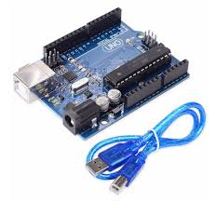
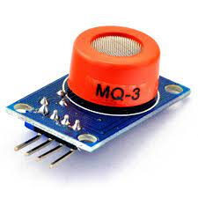
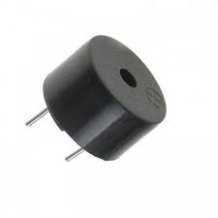
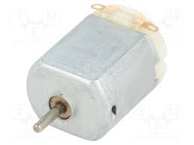
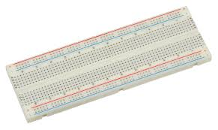
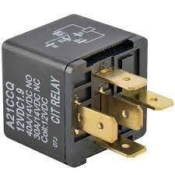
Arduino with cable - 350 INR MQ3 sensor - 80 INR Buzzer - 60 INR
COMPONENTS COST
DC Motor -30 INR Breadboard - 50 INR Relay - 20 INR

Slide 6
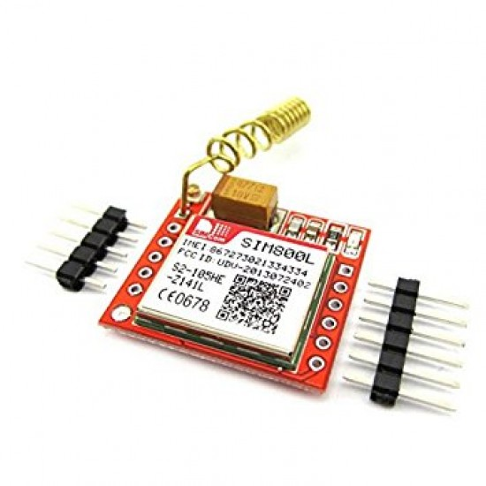
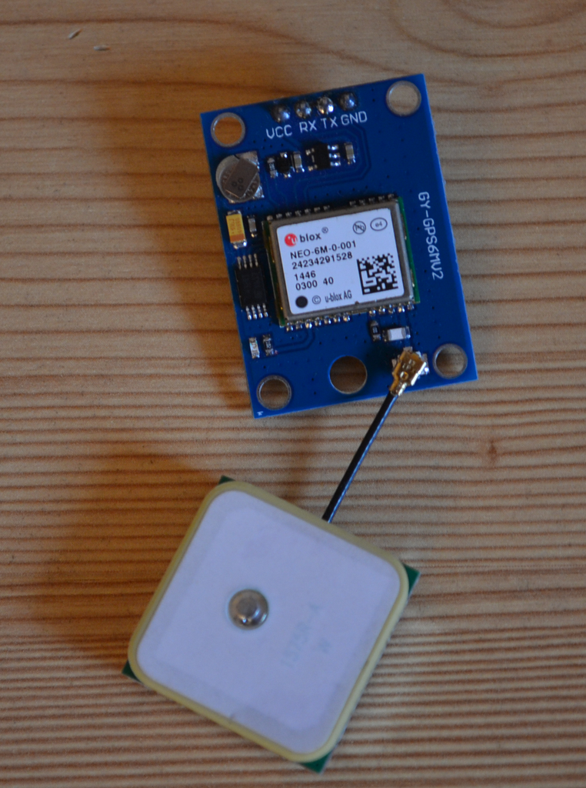
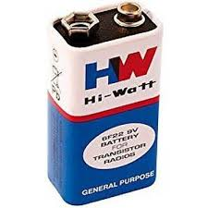
GSM GPRS Module - 275 INR GPS Module Neo 6M - 400 INR Battery - 50 INR
TOTAL COST = 1850 INR

Slide 7
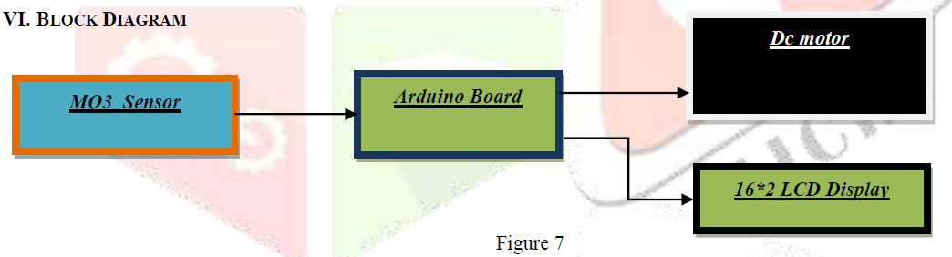
WORKING
Dc motor:- Normally dc motor is in running condition . At that time red led is off & the % of alcohol is less than 200. But when the
% of alcohol will increase above 200, then the motor will stop and red led will glow.
MQ3 Sensor: - We use sanitizer with alcohol conc to demonstrate the project. In this project the MQ 3 sensor is used as an alcohol sensor. It senses the % of ethanol molecule. The sensor can operate at temperatures from -10 to 50°C and consumes less than 150 mA at 5 V.
Arduino board: - It is an embedded system which we used for controlling the whole section. According to the signal of MQ3 sensor it
controls the working of dc motor. It also controls the LCD display module.
Darlington pair:- Here Darlington pair is used to increase the current rating to run the dc motor.
Freewheeling diode: - We used freewheeling diode across the dc motor to reduce the inductive effect.
LCD display: - Here we used LCD display to show the percentage of alcohol.
VI. BLOCK DIAGRAM
Figure 7

Slide 8
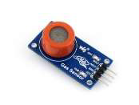

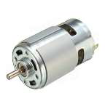
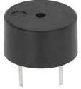
When the % of ethanol will increase above the stated value, then it gives a signal to Arduino.
Arduino board: - It is a microcontroller used for controlling the whole section. According to the signal of MQ3
Sensor It controls the working of dc motor using relay ,
Relay controls the dc motor according to Arduino signals .When alcohol is detected arduino gives high signal
to the relay therefore stopping the dc motor.
LCD display - lcd or the Serial monitor in the Arduino IDE displays the alcohol concentration detected and
Therefore controls the buzzer and the dc motor.

Slide 9
Buzzer - when the alcohol molecules are detected by MQ 3 the buzzer starts beeping and the led glows
When the detected alcohol concentration is relatively very high in addition to the engine lock the
location and the condition of the driver is shared to family contacts using GPS and GSM module.
GPS is used to fetch the exact location of the vehicle .This is based on time and known positions of
specialised satellites .
GSM modem accepts a sim card and operates over a subscription to a mobile operator just like a mobile
Phone . it is a cost effective solution for receiving SMS. Arduino sends commands to GSM and
It operates accordingly .

Slide 10
FUTURE ENHANCEMENT (current model):
We can implement Heart rate pulse variability to find accurately & identify the driving behaviour of drivers
and to assist them by sending emergency alert to nearby Health care center.
CONCLUSION
An effective solution is provided to develop the intelligent system for vehicles which will monitor various parameters of vehicle and send to the base unit .
By using hardware platform who’s Core is Arduino, Alcohol sensor mq3. The whole Control system has the advantage of small volume and high reliability.
This system also aims to control the accidents and providing useful details about the accidental vehicle, thereby reducing the rate of accidents taking place due to drunken driving.
This system brings innovation to the existing technology in the vehicles and also improves the safety features, hence proving to be an effective development in the automobile industry.

Slide 11
REVIEW 2 Expectations
1 . What if the person beside the driver is drunk?
We can cover the circumference of the MQ3 sensor so that the directivity is only towards the driver
2 Placing of the sensor ?
The sensor can be placed on the steering wheel .
3 Will the doors and windows get locked up on alcohol detection?
No, when the alcohol concentration is detected the engine goes off while the doors and windows are left open .
4 is it suitable for every class of vehicle?
Yes, Provided it has closed cabin (ex: car, Bus, Truck).

Slide 12
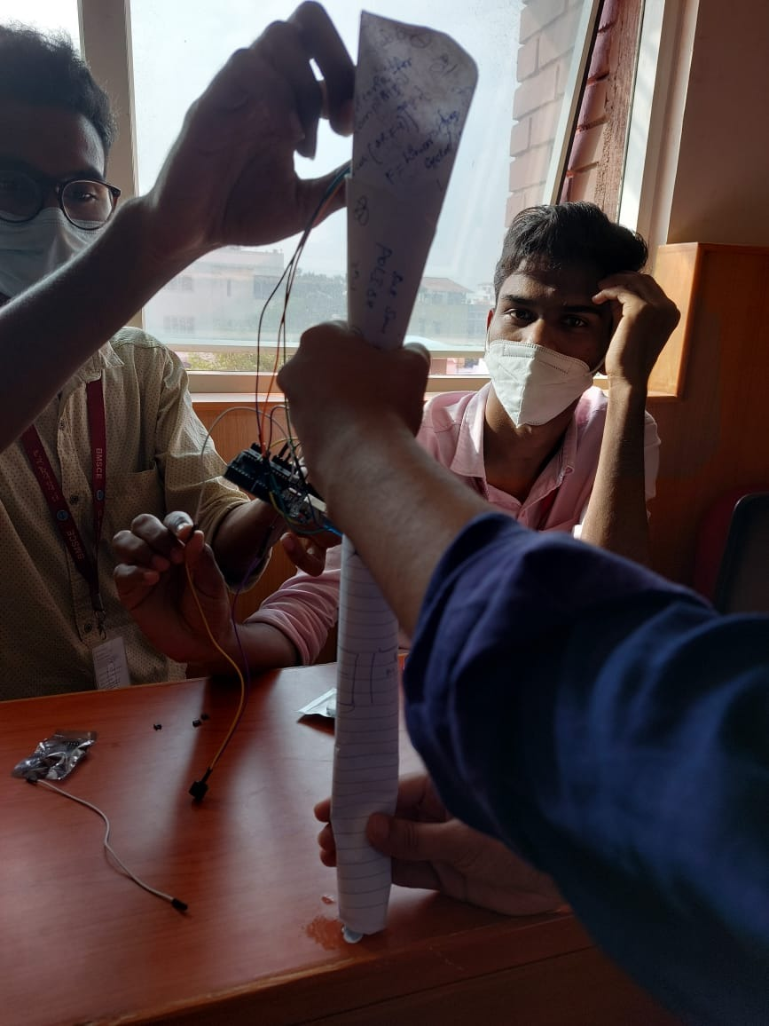
Demonstrating the range of the MQ3 SENSOR
Range : 0.6 m or more

Slide 13
https://www.ijert.org/automatic-engine-locking-system-through-alcohol-detection
http://howtomechatronics.com/projects/arduino-radar-project/
Reference

